Slide 1
WGST 100-991: Introduction to Women’s and Gender Studies
Week 5: Wednesday, Oct. 3/18
Construction of Sex and Gender: The Waves Part II

Slide 2
Second Wave of Feminism: Changes in Law
Canada Human Rights Act, 1977
Equal pay for equal work of equal value
No discrimination based on race, sex, religion or disability.
Canadian Human Rights Commission created out of the Act to investigate and settle complaints within federal jurisdiction.

Slide 3
Second Wave of Feminism: Changes in Law
Charter of Rights and Freedoms
Part of the Constitution Act, 1982
Important Sections:
Section 15: equal treatment before and under the law, and equal protection and benefit of the law without discrimination
Section 28: states all Charter rights are guaranteed equally to men and women
One of the lobby groups in the negotiations that gave a presentation was none other than the National Action Committee on the Status of Women.

Slide 4
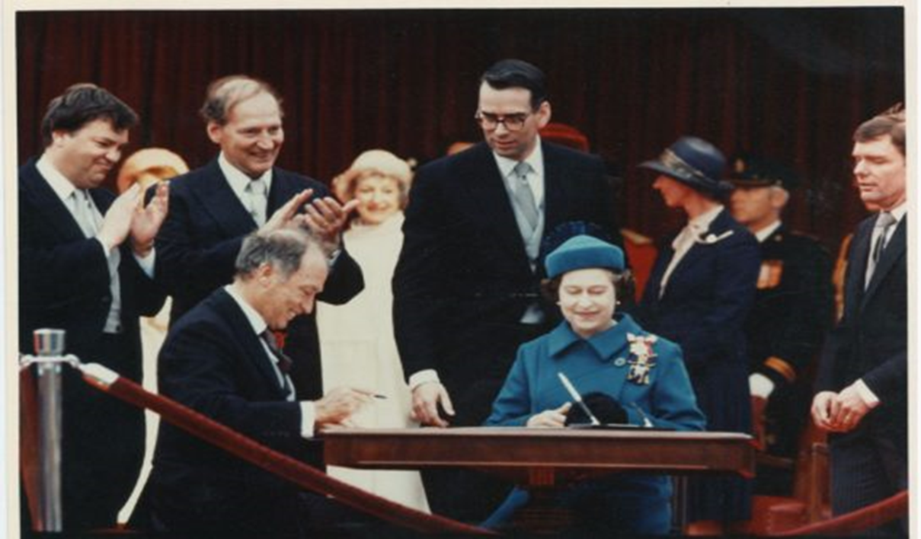
Second Wave of Feminism: Changes in Law

Slide 5
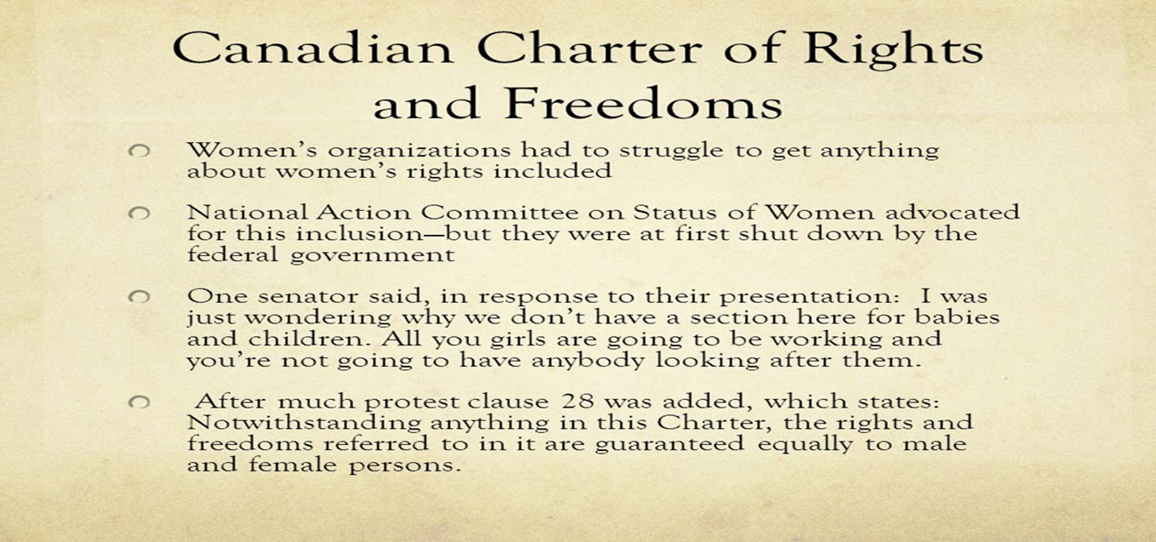
Second Wave of Feminism: Changes in Law

Slide 6
Second Wave of Feminism: Reproductive Freedoms
Abortion:
Illegal in Canada until 1969.
Had to be performed in a certified hospital, approved by a medical committee, and be crucial to a woman’s health.
Still considered a crime under Sec. 287 of the Criminal Code, however.

Slide 7
Second Wave of Feminism: Reproductive Freedoms (Abortion)
R v Morgentaler (1988) Case.
https://www.youtube.com/watch?v=T7e0j7BFKoo&t=31s
Dr. Henry Morgentaler opens abortion clinics in Montreal
Defense: section 7 of the Charter says "Everyone has the right to life, liberty and security of the person and the right not to be deprived thereof except in accordance with the principles of fundamental justice.“
1988 Supreme Court of Canada Rules in Morgentaler’s favor.
Abortion has been legal in Canada since.

Slide 8
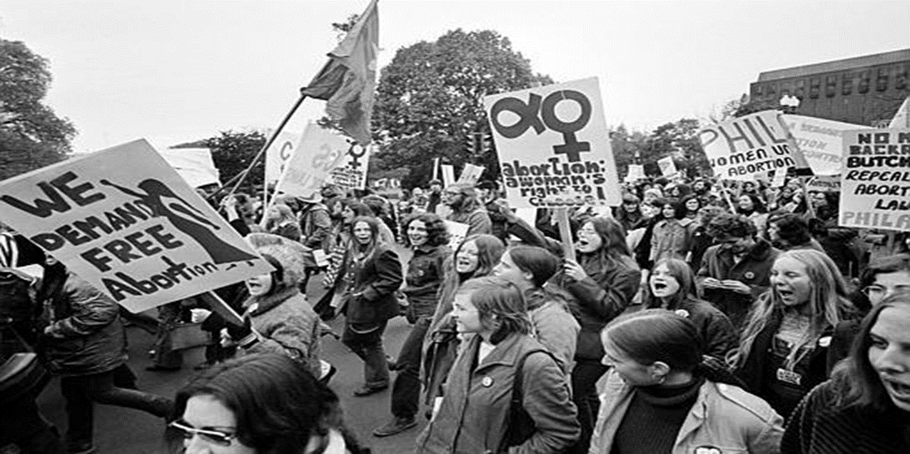
Second Wave of Feminism: Reproductive Freedoms (Abortion)

Slide 9
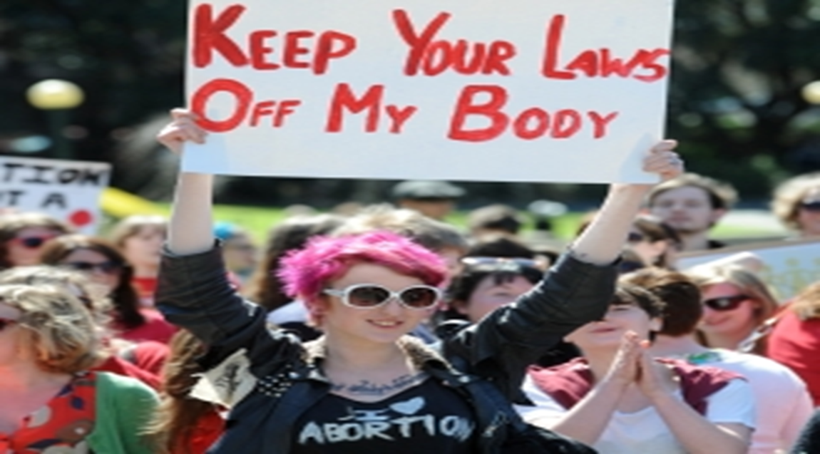
Second Wave of Feminism: Reproductive Freedoms (Abortion)

Slide 10
Second Wave of Feminism: Reproductive Freedoms (The Pill)
Co-invented by birth control activist Margaret Sanger (the idea and funder) and Biologist Gregory Pincus in 1956-57.
Enovid approved by the FDA for treatment of “menstrual disorders.”
Becomes so popular it makes the cover of Time Magazine in 1967.

Slide 11
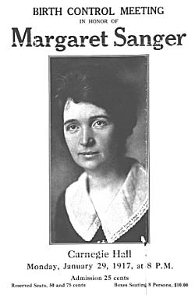
Second Wave of Feminism: Reproductive Freedoms (The Pill)

Slide 12

Second Wave of Feminism: Reproductive Freedoms (The Pill)

Slide 13

Second Wave of Feminism: Reproductive Freedoms (The Pill)

Slide 14
Second Wave of Feminism: Reproductive Freedoms (the Pill)
Gives woman unprecedented control over fertility.
A key role in in forming modern female economic control.
Popularity in that it separates from sexual intercourse (unlike other contraceptives) and makes its choice in use a wholly private one.
Soon after the birth control pill was legalized, there was a sharp increase in college attendance and graduation rates for women.
The ability to control fertility without sacrificing sexual relationships allowed women to make long term educational and career plans.
Ushered in the Sexual Revolution.

Slide 15
Second Wave of Feminism: Reproductive Freedoms (the Pill)
In Canada
The pill had been available with a doctor's prescription to Canadian women as early as 1957, but only for "menstrual irregularities" — never (at least officially) as a means of avoiding conception.
At the time, advertising or selling contraceptives could result in a fine or jail time, unless it could be shown to be in the "public good.“
illegal in Canada until 1969, when a Trudeau government bill that also legalized "therapeutic" abortions and homosexual acts between consenting adults was passed by Parliament.

Slide 16
Second Wave of Feminism: Reproductive Freedoms (the Pill)
Early arguments against it:
Catholic Church-Prescribing the oral contraceptive to young single females would lead to a breakdown in morality and rampant sexual promiscuity/
Medical Community-that the pill made women unfeminine and that some patients complained "they were no longer interested in their homes, in their children, even in their husbands.“
Politics-A Toronto Liberal MP, who vocally opposed his party's bid to legalize contraception, proclaimed in 1966 that use of the pill was already emptying out hospital maternity wards.
“What we need is not birth-control, but self-control," Ralph Cowan told the now-defunct Weekend Magazine. "If things go on this way, in 20 years we'll have so many old people there won't be enough young people to pay for their welfare programs.”

Slide 17
Second Wave of Feminism: Violence against Women
As per StatsCanada:
Of every 100 incidents of sexual assault, only 6 are reported to the police
1 - 2% of "date rape" sexual assaults are reported to the police
1 in 4 North American women will be sexually assaulted during their lifetime and 11% of women have physical injury resulting for sexual assault
Only 2 - 4% of all sexual assaults reported are false reports
80% of all sex crime victims are women
17% of girls under 16 have experienced some form of incest
83% of disabled women will be sexual assaulted during their lifetime
half of all sexual offenders are married or in long term relationships
57% of aboriginal women have been sexually abused
80% of assailants are friends and family of the victim

Slide 18
Second Wave of Feminism: Violence against Women
Separate but equal spaces for women.
The idea of unequal power relations in the private sphere.
Women in culture are portrayed as sex objects and dehumanized.
1963 Betty Friedan, The Feminine Mystique.
Explicitly objected to how women were depicted in the mainstream media, and how placing them at home.
The perfect nuclear family image depicted and strongly marketed at the time, she wrote, did not reflect happiness and was rather degrading for women.
“The problem that has no name.”

Slide 19
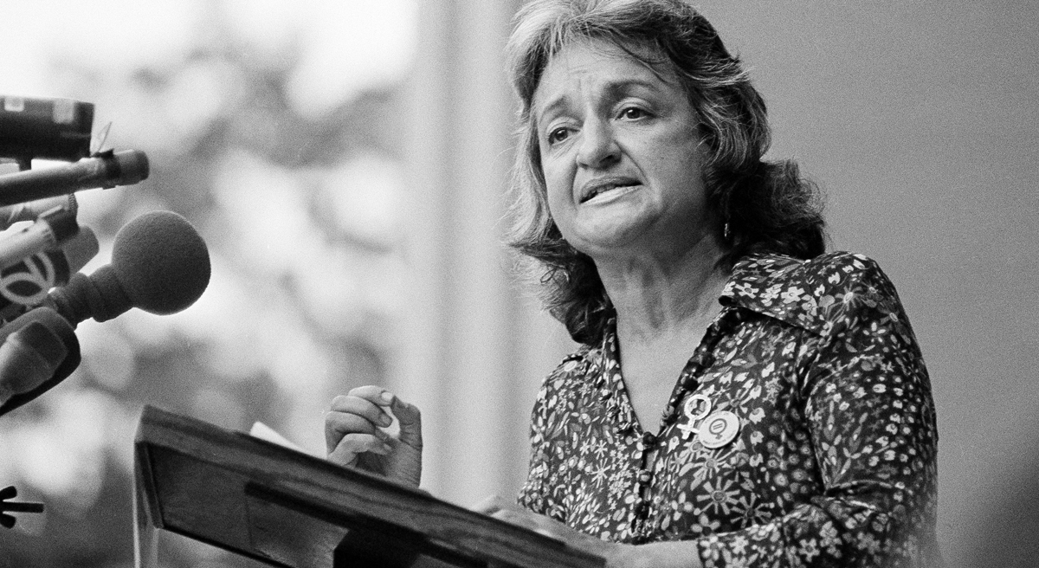
Second Wave of Feminism: Violence against Women-Betty Friedan

Slide 20

Second Wave of Feminism: Violence against Women-Nuclear Family

Slide 21

Second Wave of Feminism: Violence against Women-Advertisement

Slide 22

Second Wave of Feminism: Violence against Women

Slide 23

Second Wave of Feminism: Violence against Women

Slide 24

Second Wave of Feminism: Violence against Women

Slide 25
Second Wave of Feminism: Violence against Women
In Canada
The Battered Women’s Shelter Movement in Canada emerged predominantly during the late 1960s and early 1970s, within the framework of second wave feminism.
Building on the oft-used second wave slogan, “the personal is political, second wave understandings of the state's role in regulating private life paved the road for a re-conceptualization of domestic violence as a social problem as opposed to a completely private matter.
The movement was generated in large part because for women who had experienced domestic violence, “there was no place to go.”
However, several feminists have criticized the Battered Women's movement for its reliance on the battered woman-as-victim archetype.[

Slide 26
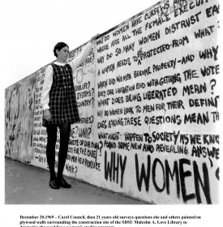
Second Wave of Feminism: Violence against Women

Slide 27
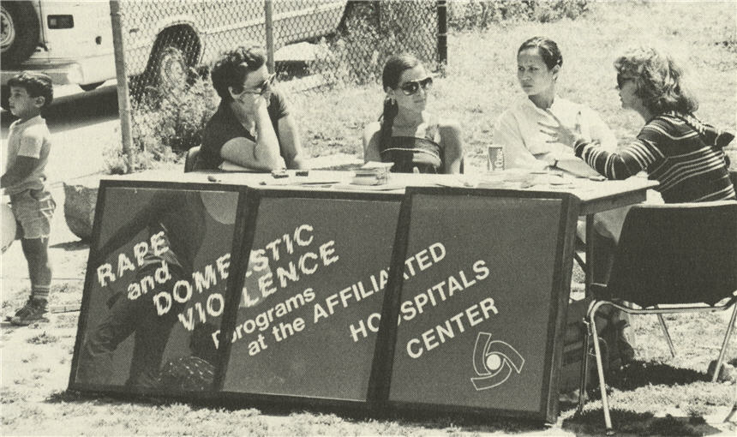
Second Wave of Feminism: Violence against Women

